Slide 1


Model Management in Xtend (first part)
Mathieu Acher
Maître de Conférences
mathieu.acher@irisa.fr

Slide 2
Material
https://github.com/acherm/teaching-MDE-MIAGE1718

Slide 3
Plan
Model Management in a nutshell
Loading, serializing, transforming models
Xtend
Java 10, cheatsheet
Advanced features: extension methods, active annotations, template expressions
Xtend: behing the magic (Xtext+MDE)
Model Management + Xtend
Model transformations
@Aspect annotation
Xtend + Xtext (breathing life into DSLs)

Slide 4
Contract
Practical foundations of model management
Learning and understanding Java 10 (aka Xtend)
advanced features of a general GPL, implementation of a sophisticated language using MDE
Model transformations
Model-to-Text
Model-to-Model
Metaprogramming
Revisit annotations (e.g., as in JPA or many frameworks)
DSLs and model management: all together (Xtext + Xtend)

Slide 5
Model
Management
Scenarios

Slide 6
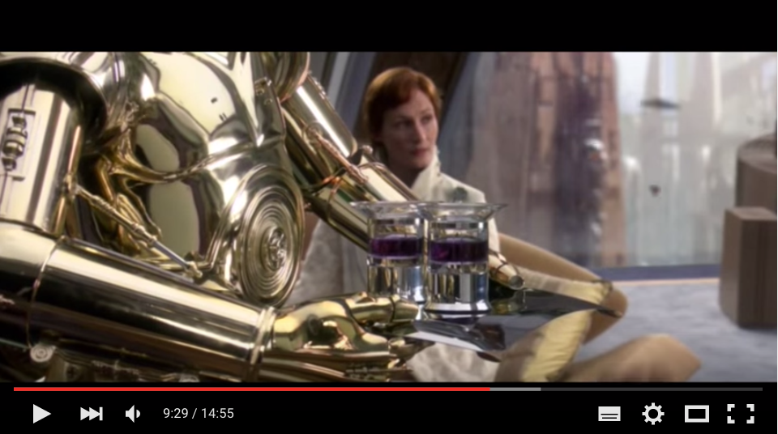
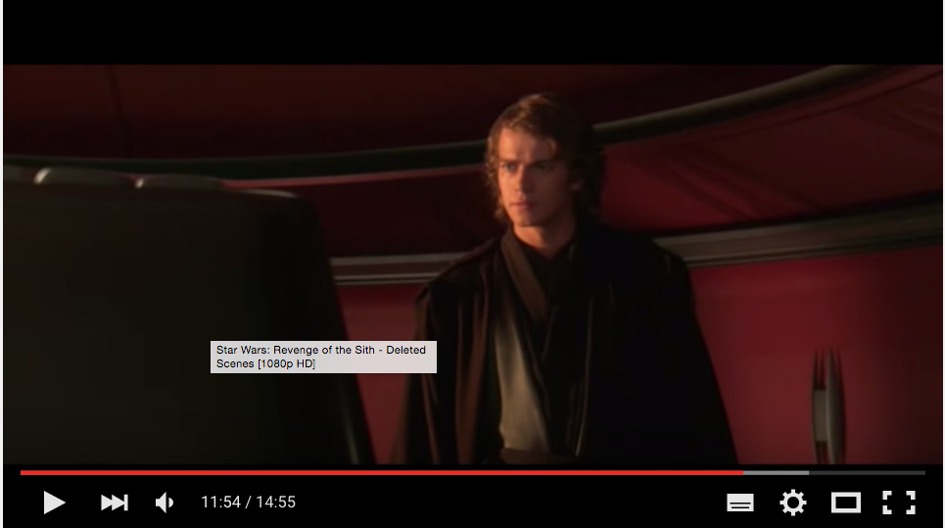
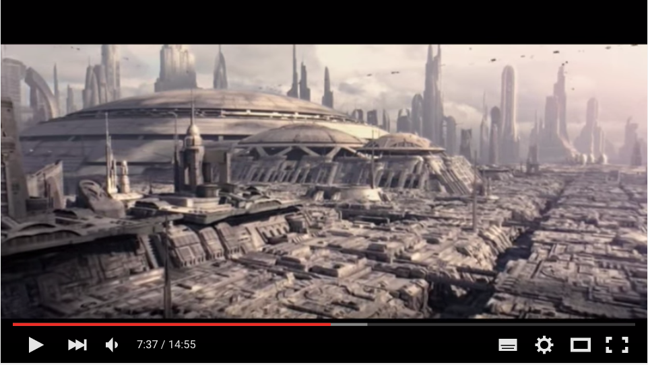



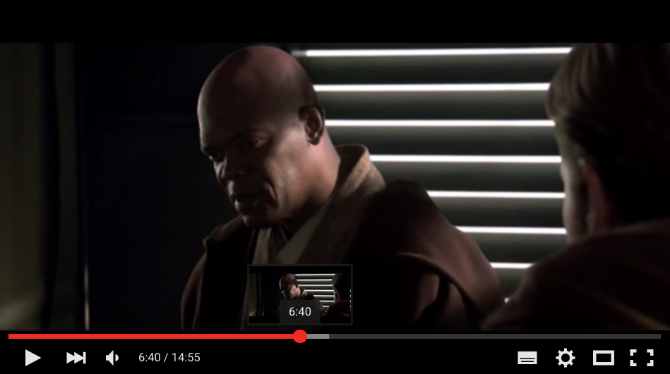

Generator
~ composition of video sequences
video variants

Slide 7

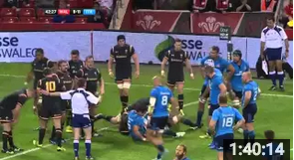
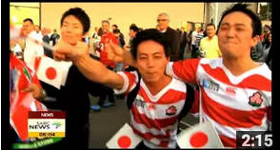

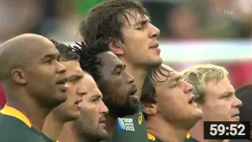

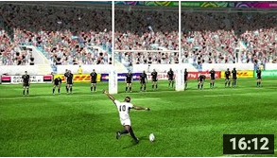
Generator
~ composition of video sequences
video variants

Slide 8
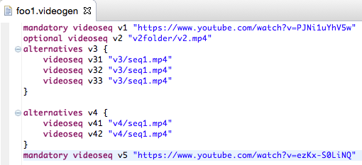
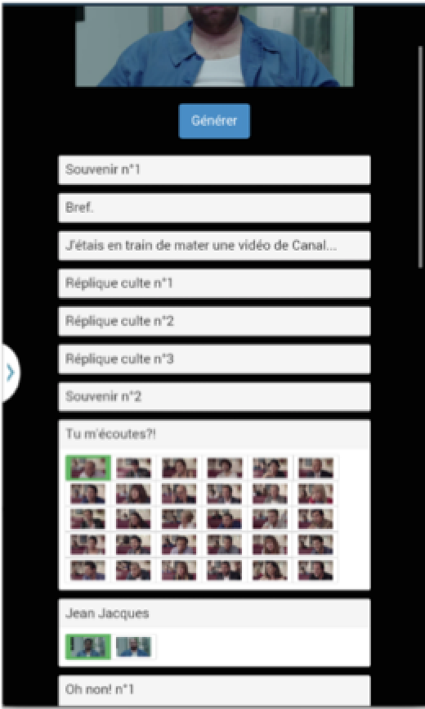
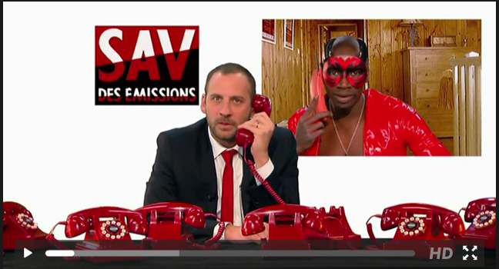
Website/online
Random generation
Configurator
Game
…

Slide 9







Slide 10
#1 How to design, create, and support dedicated languages (DSLs)?
#2 How to transform models/programs?
#3 How to manage variability/variants?
#4 How do frameworks internally work?

Slide 11
model-to-text
# this is a comment
file ‘v3/seq1.avi'
file '/path/to/video2.avi'
file '/path/to/video3.avi'

Slide 12

model-to-text
v3/seq1.avi
/path/to/video2.avi
/path/to/video3.avi
.m3u

Slide 13

model-to-text
#EXTM3U
#EXT-X-DISCONTINUITY
#EXTINF:3
resources/videos/vp0-logo/logo_start.ts
#EXT-X-DISCONTINUITY
#EXTINF:12
resources/videos/vp1-QR/QR05_1.ts
#EXT-X-DISCONTINUITY
#EXTINF:2
resources/videos/vp2-intro-fluide-glacial/EtPendantCeTempsLaEn1975_processed.ts
.m3u (extended)

Slide 14
model-to-model
playlist
metamodel
playlist model
model-to-text

Slide 15
model-to-*
Thumbnails (vignettes) of each video sequence (e.g., PGN format)

Slide 16
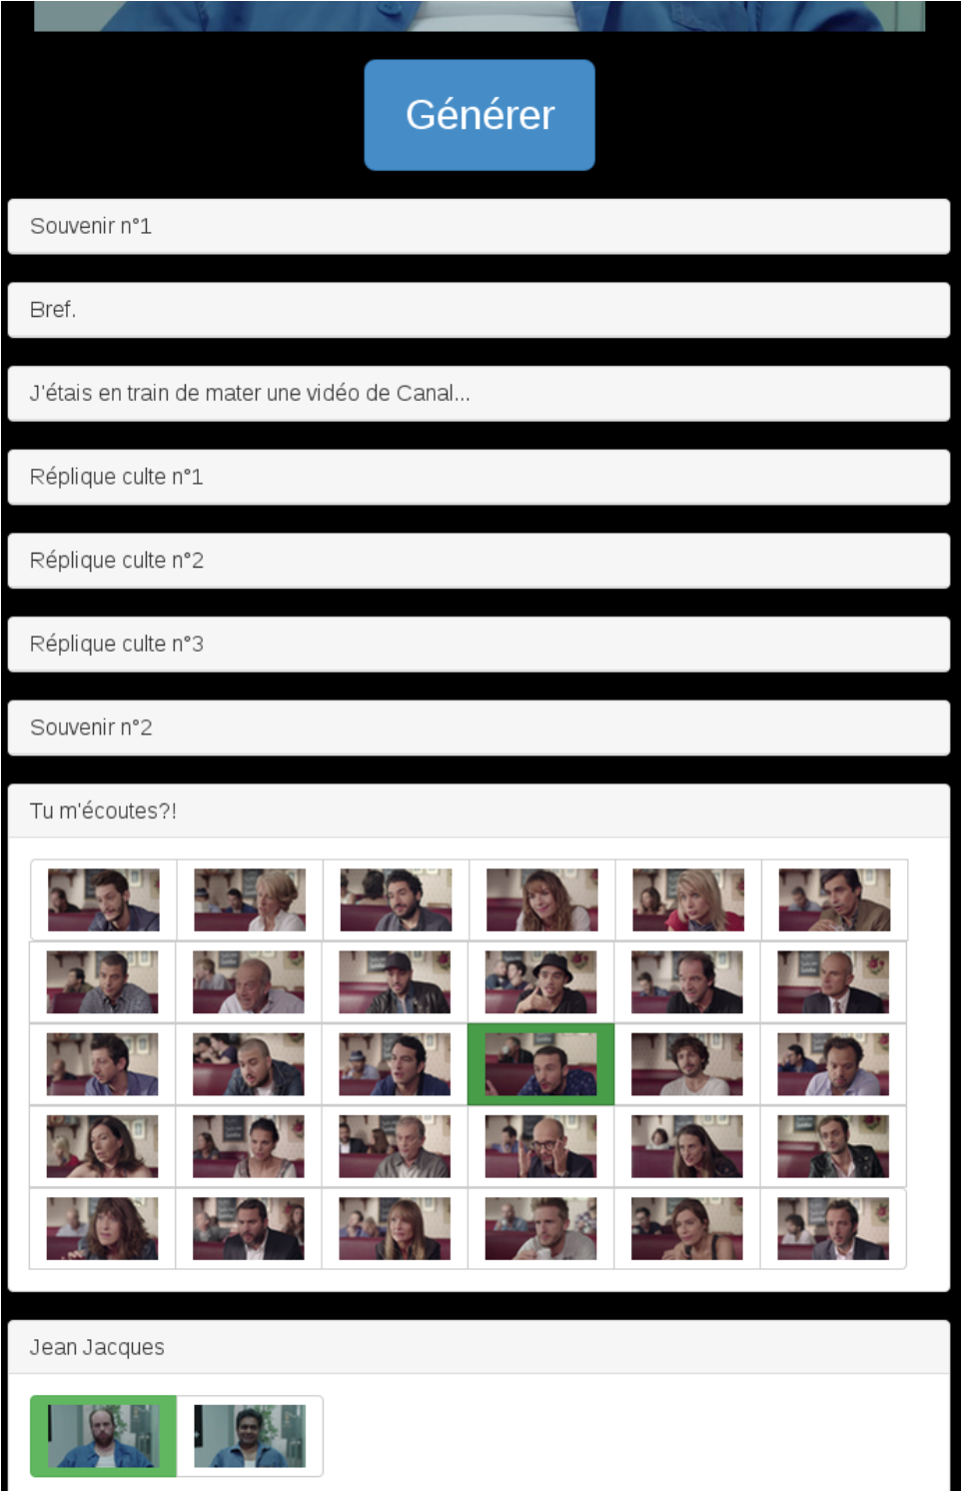
model-to-*
Thumbnails (vignettes) of each video sequence (e.g., PGN format)

Slide 17
model-to-*
Thumbnails (vignettes) of each video sequence (e.g., PGN format)

Slide 18
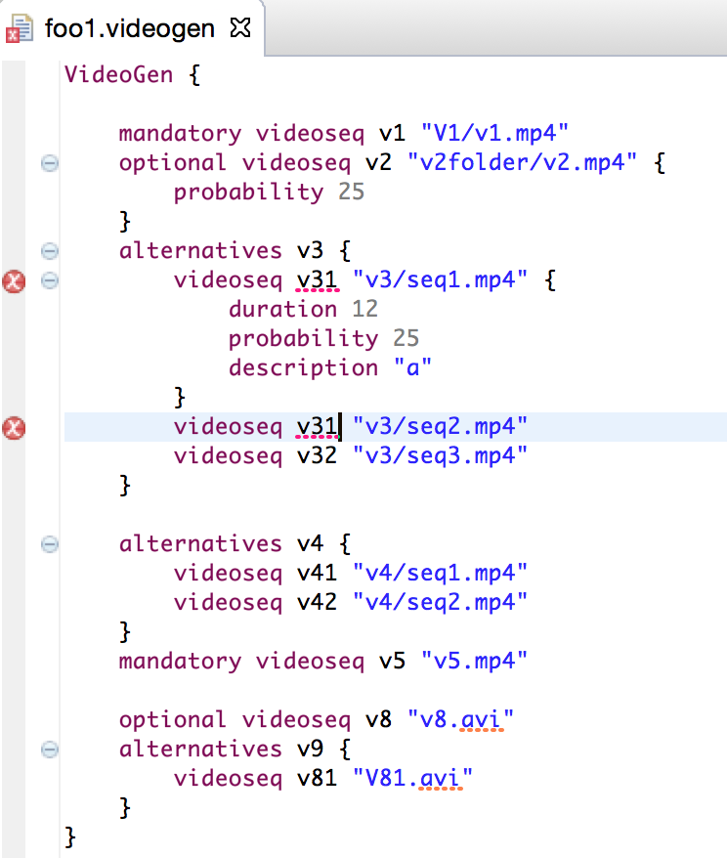


Slide 19

18, 167, 899

Slide 20
Website/online
Random generation
Configurator
Game
…

Slide 21
Feature model: another model
for modeling “features” of your
Web site (eg ability to save the
video; mode=generation
with frequencies)
Website/online
Random generation
Configurator
Game
…

Slide 22
Model
Transformations
Taxonomy + Examples

Slide 23
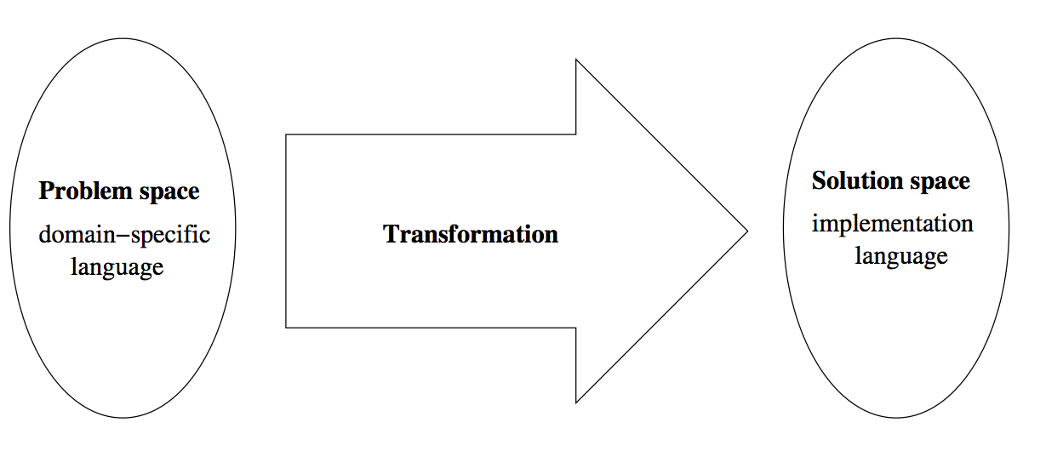

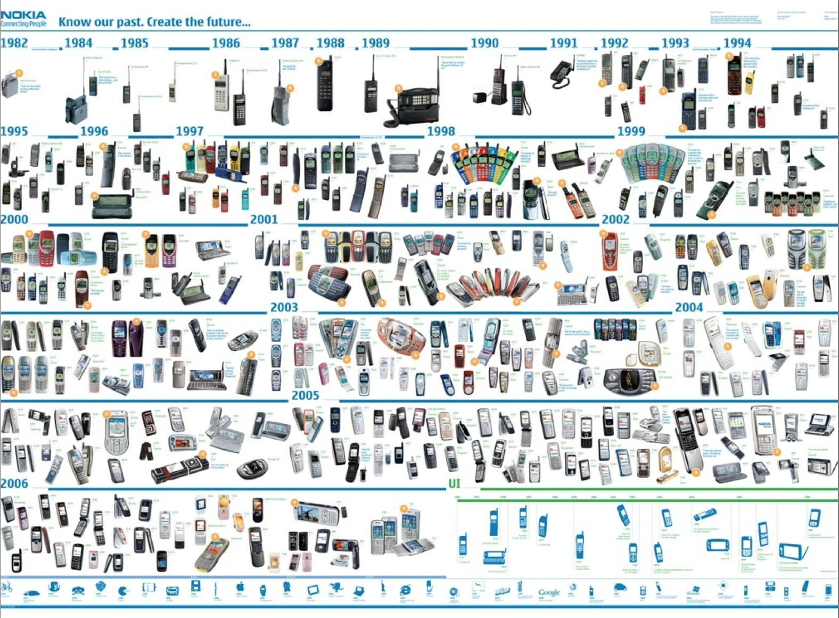


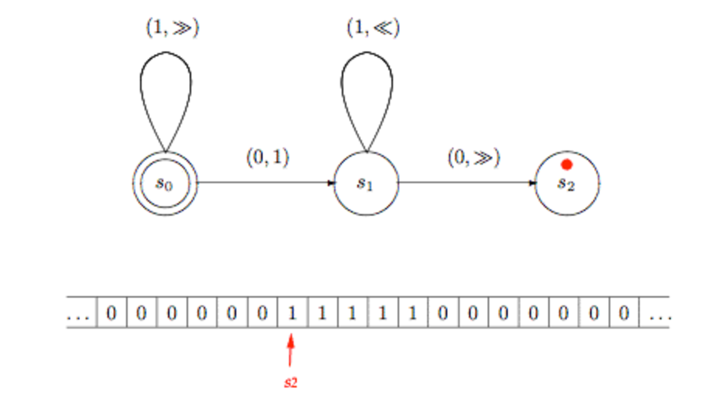


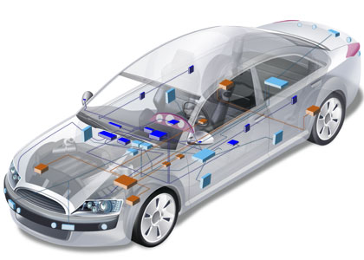

Abstraction Gap Transformation is the key

Slide 24
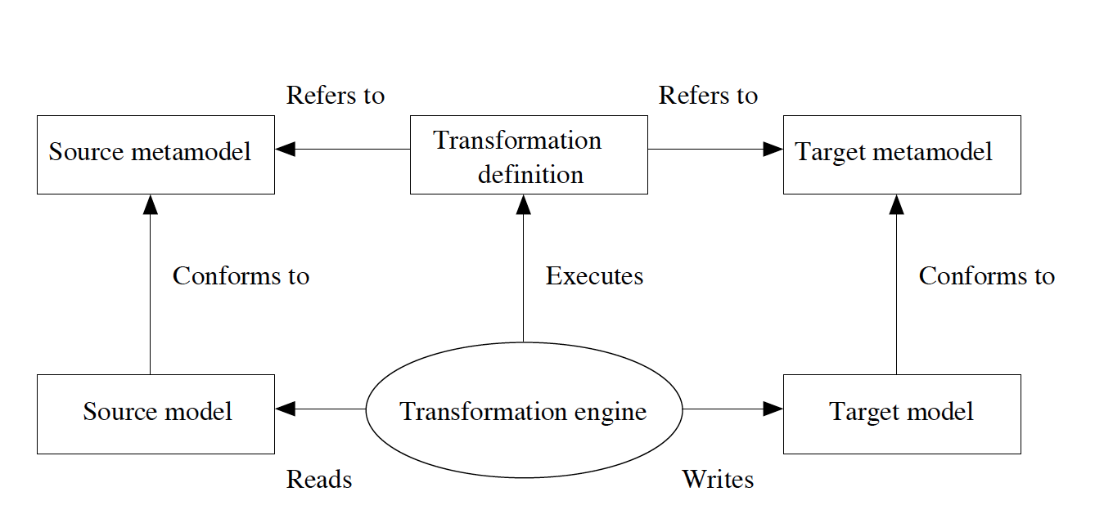

Slide 25
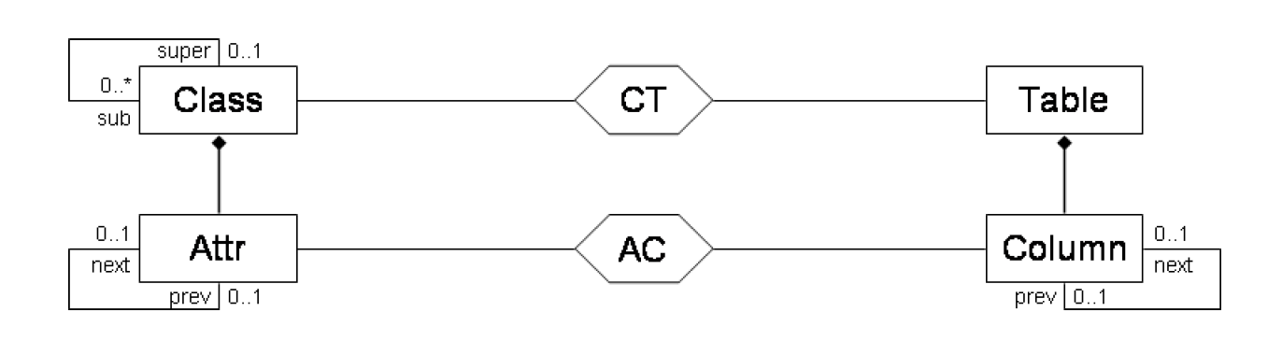
Andy Schürr, Felix Klar “15 Years of Triple Graph Grammars.” ICGT 2008
(decalarative; bi-directionnal; model-to-model)

Slide 26
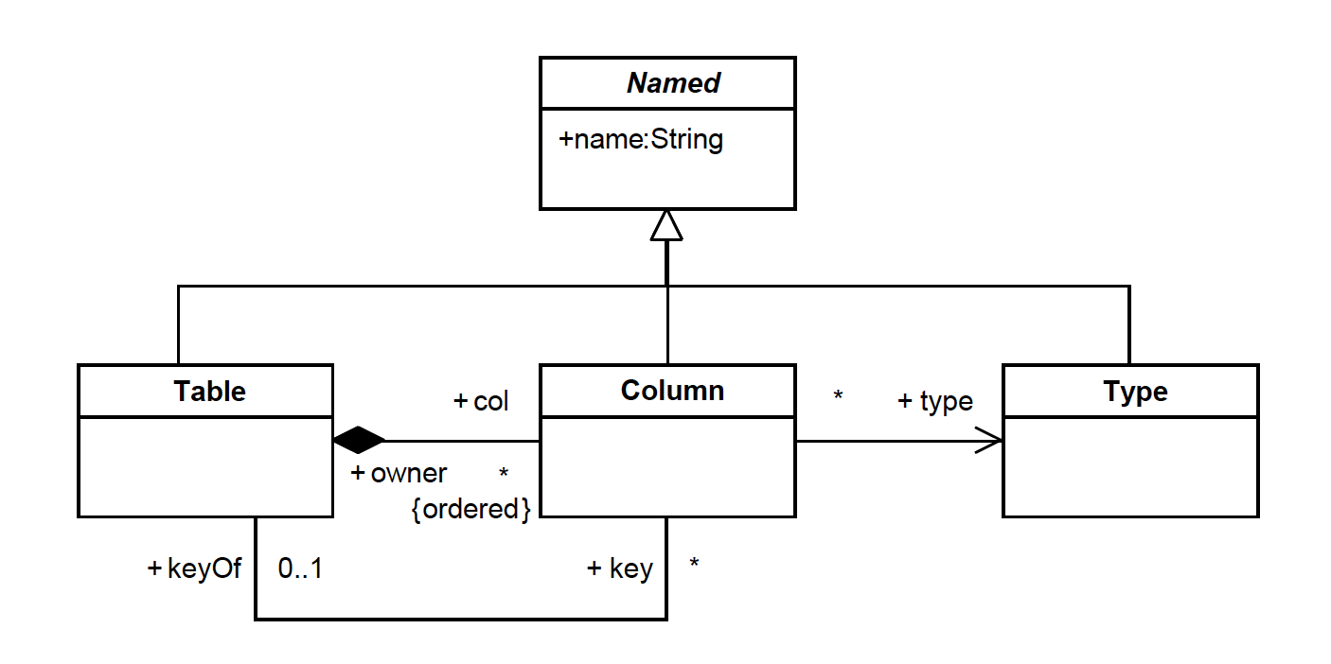
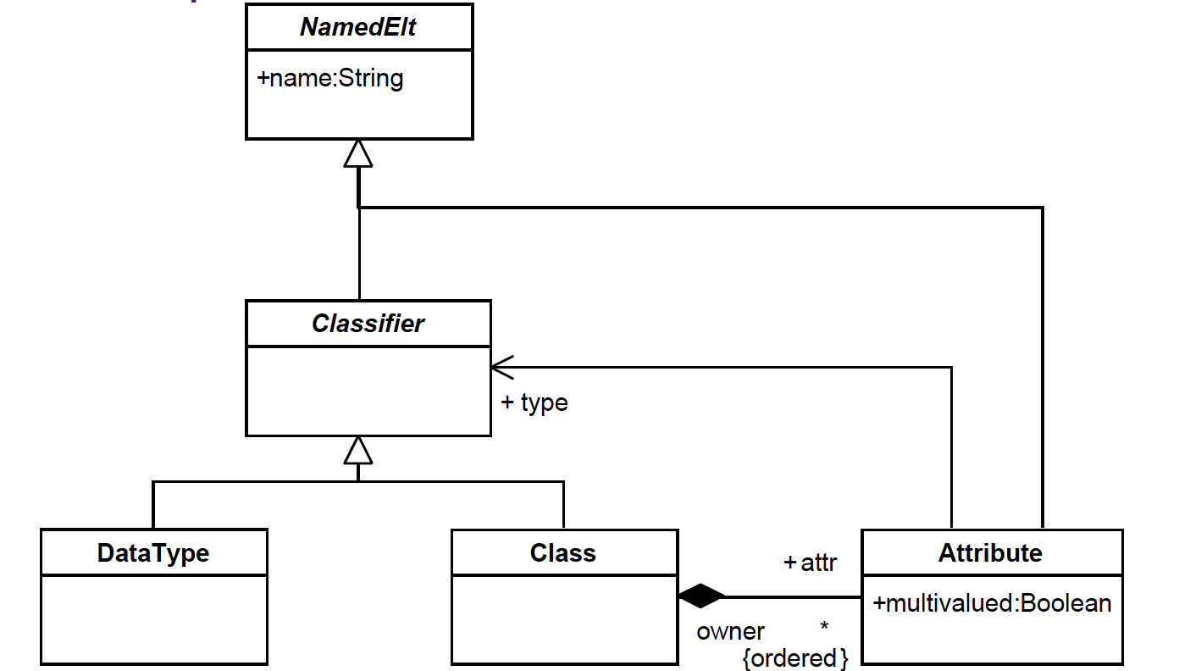
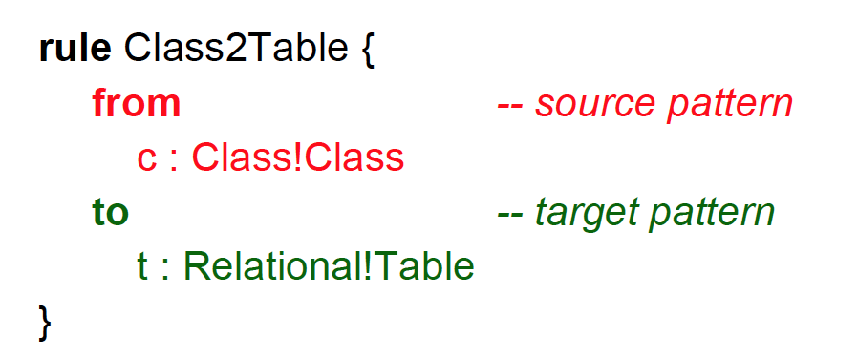
ATL (http://www.eclipse.org/atl/atlTransformations/)

Slide 27
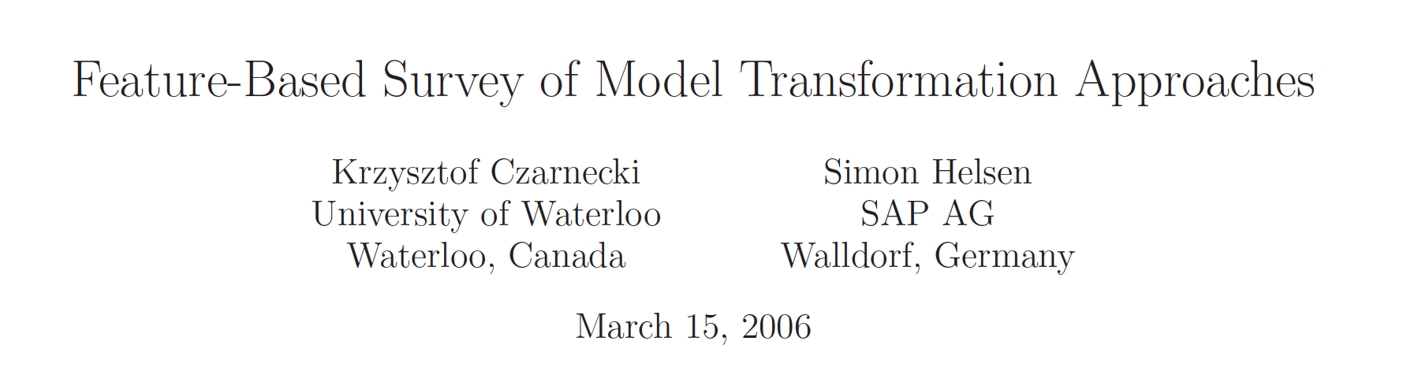

Slide 28
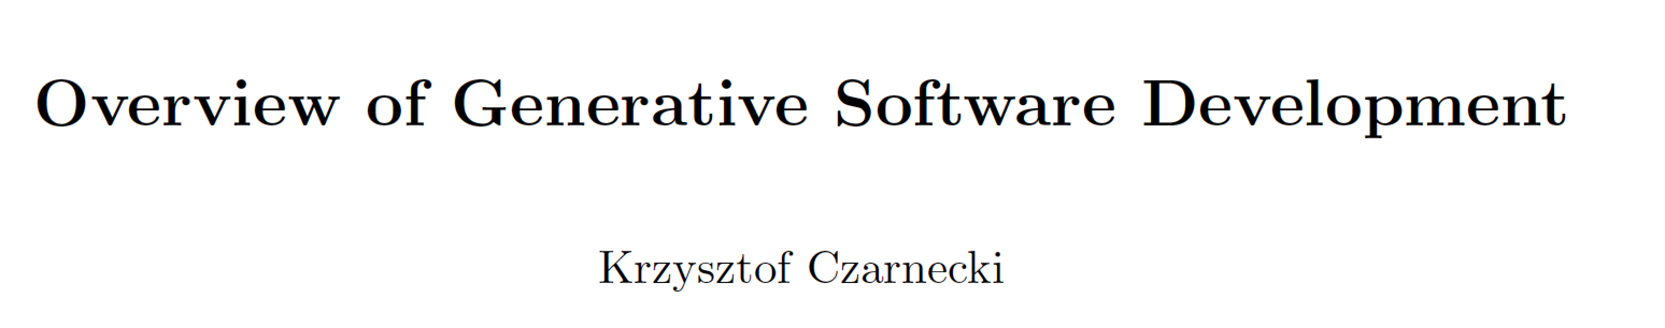
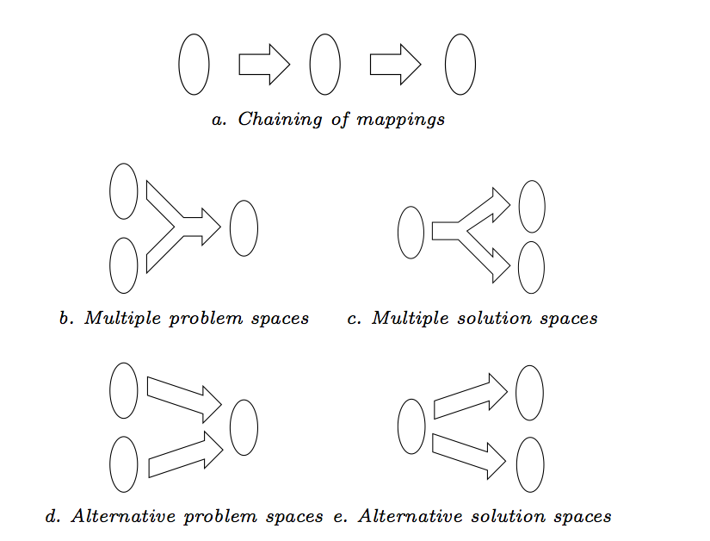

Slide 29
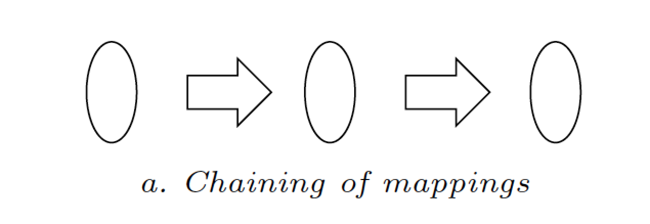
One step/stage transformation hardly the case
#EXTM3U
#EXT-X-DISCONTINUITY
#EXTINF:3
resources/videos/vp0-logo/logo_start.ts
#EXT-X-DISCONTINUITY
#EXTINF:12
resources/videos/vp1-QR/QR05_1.ts
#EXT-X-DISCONTINUITY
#EXTINF:2
resources/videos/vp2-intro-fluide-glacial/EtPendantCeTempsLaEn1975_processed.ts
Playlist model
.m3u (extended)

Slide 30
One step/stage transformation hardly the case
#EXTM3U
#EXT-X-DISCONTINUITY
#EXTINF:3
resources/videos/vp0-logo/logo_start.ts
#EXT-X-DISCONTINUITY
#EXTINF:12
resources/videos/vp1-QR/QR05_1.ts
#EXT-X-DISCONTINUITY
#EXTINF:2
resources/videos/vp2-intro-fluide-glacial/EtPendantCeTempsLaEn1975_processed.ts
Playlist model
.m3u (extended)

Slide 31
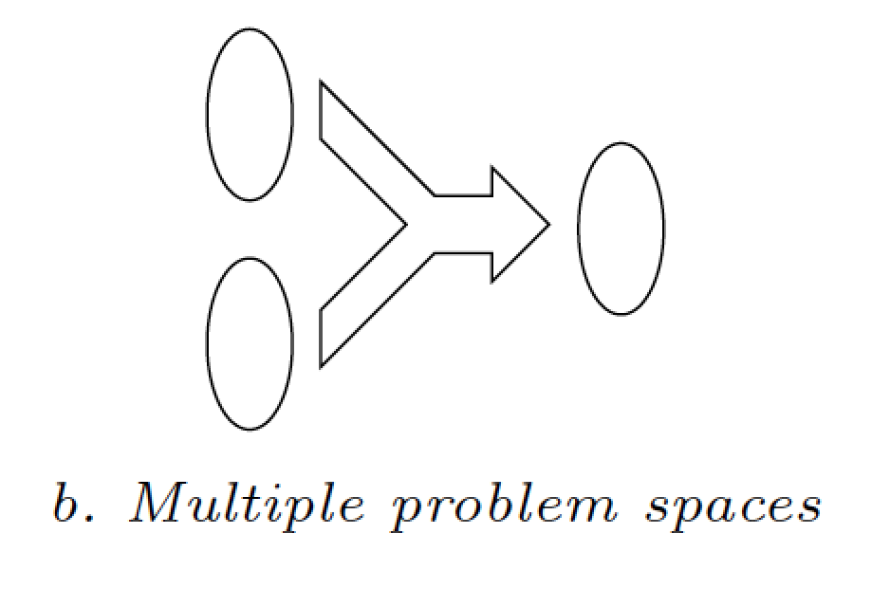
Problem space Combination of expertises/aspects/DSLs
Feature model: another model
for modeling “features” of your
Web site (eg ability to save the
video; mode=generation
with frequencies)

Slide 32
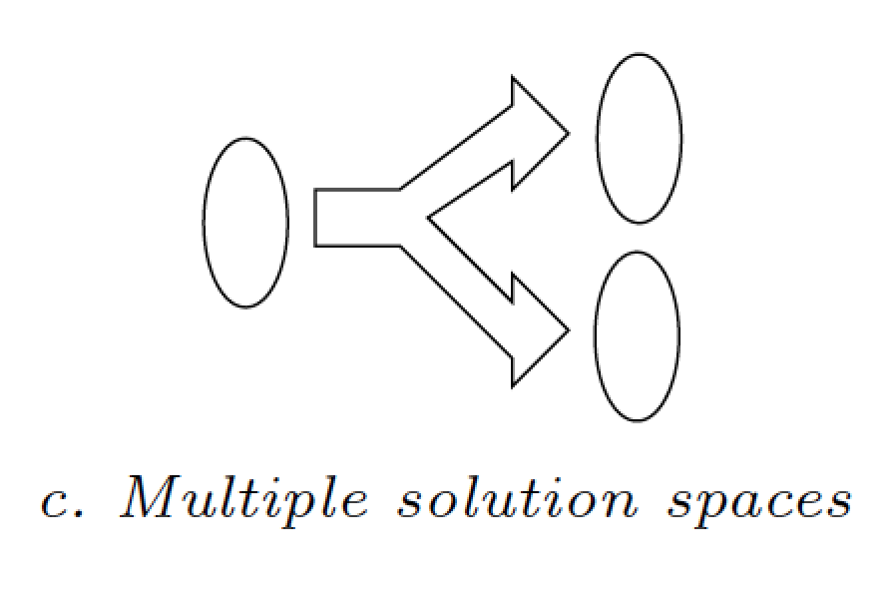
Solution space Different targets (e.g., technological platforms)
.m3u (extended)
Playlist model

Slide 33
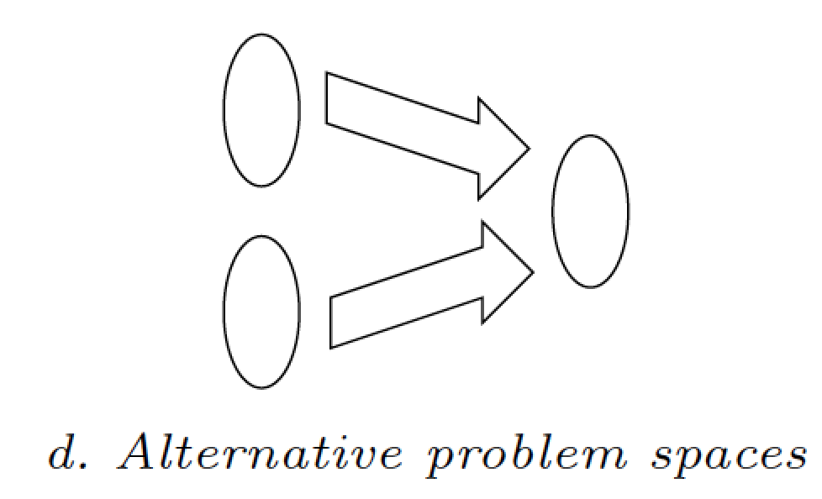
Problem space e.g., different concrete syntaxes
Video Variants
Feature Model
(see next courses)

Slide 34
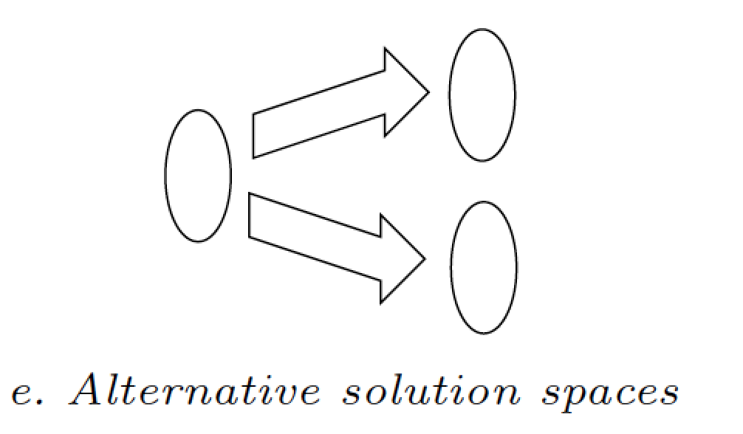
Solution space Different targets (e.g., technological platforms)
Playlist model

Slide 35
Model Transformation: Taxonomy

Slide 36
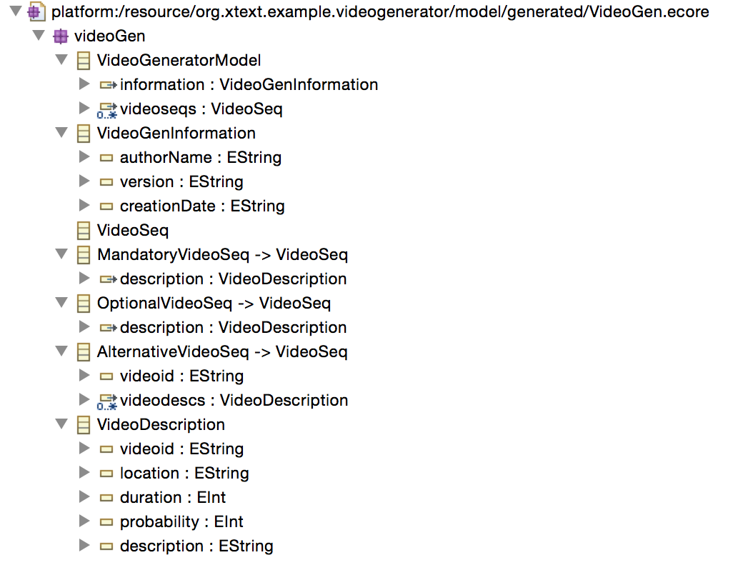
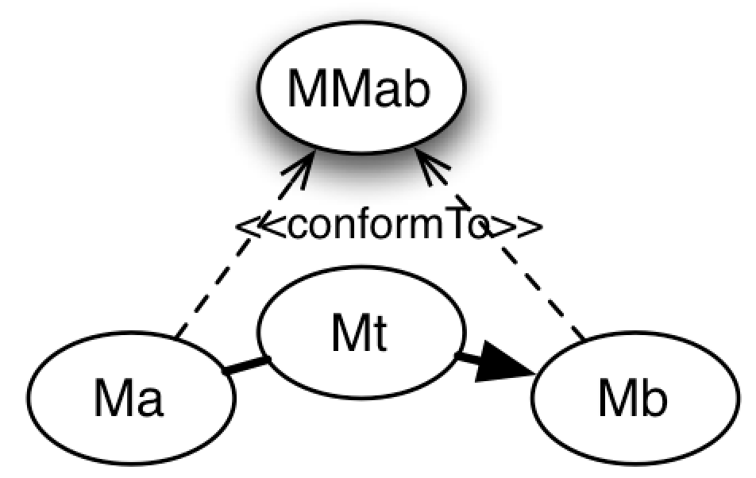
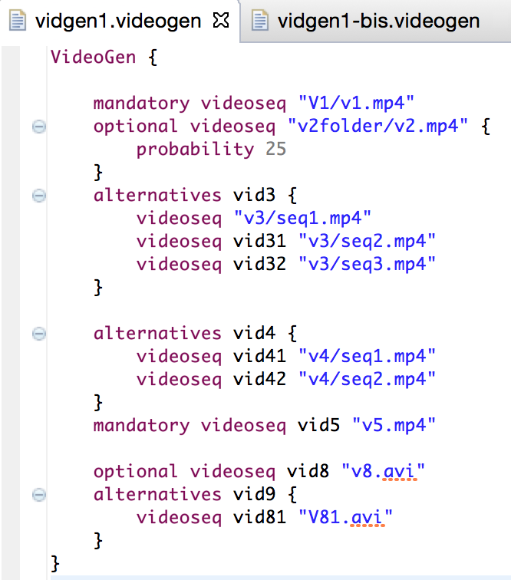
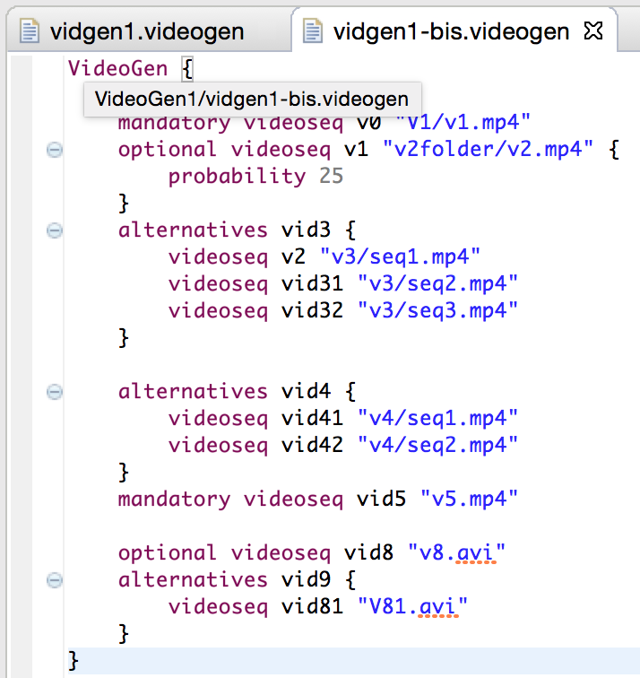
Endogeneous Transformation

Slide 37

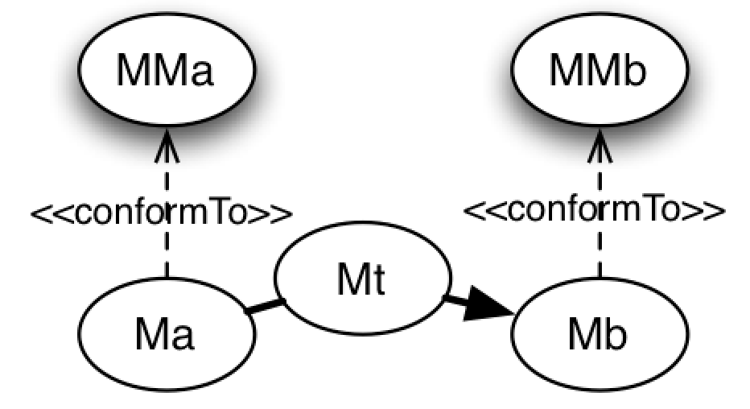
Exogeneous Transformation
(metamodel)
<ul>
<li>v0</li>
<li>v1</li>
<li>vid3</li>
<ul>
<li>v2</li>
<li>vid31</li>
<li>vid32</li>
</ul>
<li>vid4</li>
<ul>
<li>vid41</li>
<li>vid42</li>
</ul>
<li>vid5</li>
<li>vid8</li>
<li>vid9</li>
<ul>
<li>vid81</li>
</ul>
</ul>

Slide 38
Vertical Transformation source and target models reside at the same abstraction level (e.g., refactoring)

Slide 39
Chaining of Transformations Back to the first courses
Modeling
point of views
Endomorphic Transformations
Exomorphic Transformations
Outside UML scope
Proofs,
QoS
Analysis,
Simulation
Technical
Aspects
Business
Aspects
Text
(e.g. XML)
PIM=Platform Independent Model
PSM= Platform Specific Model
Formal Models
Formal Models
PIM
PSM
Code
Tests
PIM
PIM
PIM
PSM
Doc
Doc
Doc
Doc
Doc
Doc
Lifecycle
Requirements
Analysis
Architectural
Design
Detailed
Design
Implementation
Validation

Slide 40
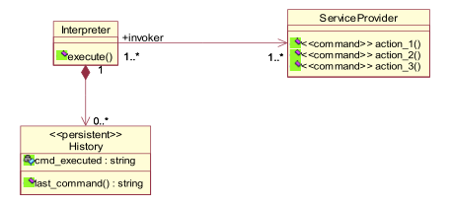
Embedding implicit semantics into a model
Design pattern application
(parametric collaboration)
Command pattern
receiver
invoker
Element stereotype
…and also
Tagged values
& Contracts

Slide 41
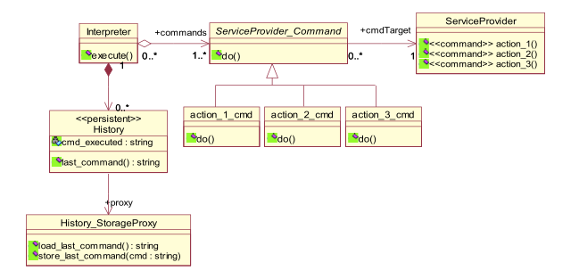
…and the result we want...

Slide 42
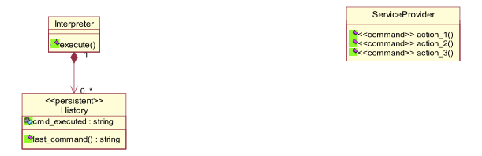
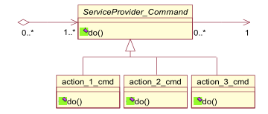
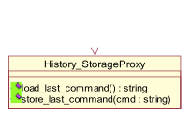
How To: Automatic Model Transformations
Command pattern implementation
In some domains (e.g.; RT systems)
transformations can get more complex
than initial model!
=> must be managed with sound SE principles
Persitence implementation

Slide 43
Quizz Time
Characterize the following model transformations
Endogeneous? Exogeneous?
Vertical? Horizontal?
Model-to-text? Model-to-Model?

Slide 44
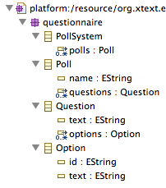
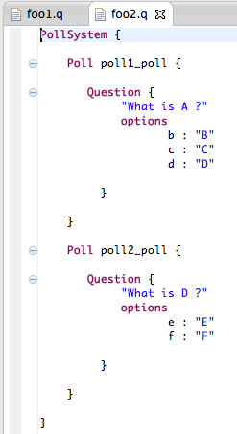
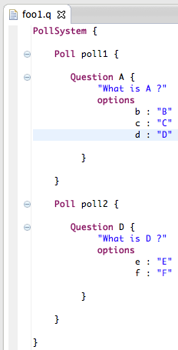
Notes:
Endogeneous Transformation

Slide 45
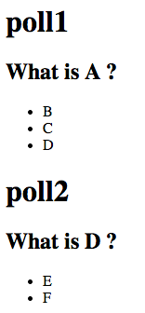
Notes:
Exogeneous Transformation

Slide 46
Xtend
A possible solution
for
model management

Slide 47


Effective Model Management
How to load/serialize a model?
How to visit, analyze and transform models?
You can do it in Java (EMF API)
We arbitrarily choose
Java 10, interesting « features »
Integration within Eclipse ecosystem (incl. Xtext) and facilities to manage models
An example of a sophisticated language

Slide 48
Before going into details of Xtend…
Recap of the scenarios
Text-to-Model
Model(s)-to-Model transformation
Metamodels as a « bridge » between techologies
Model-to-Text
The solution of some of the « scenarios »
Just to give an overview of Xtend capabilities
To give a more practical/concrete view of some of the previous scenarios

Slide 49
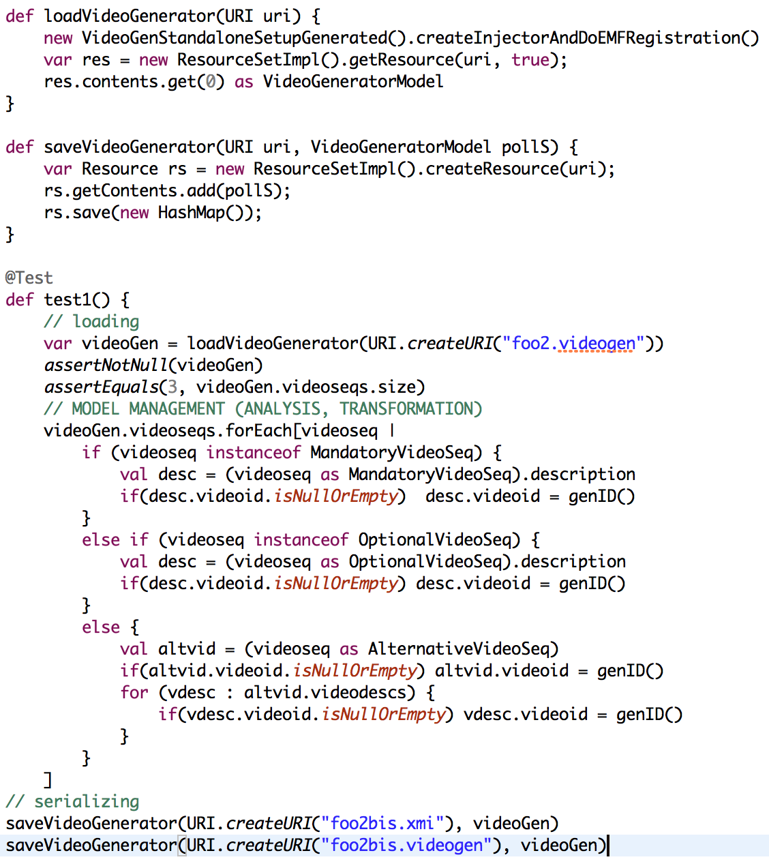
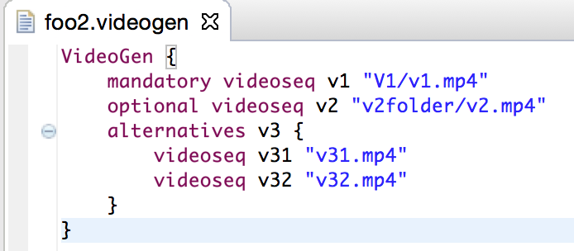

Slide 50
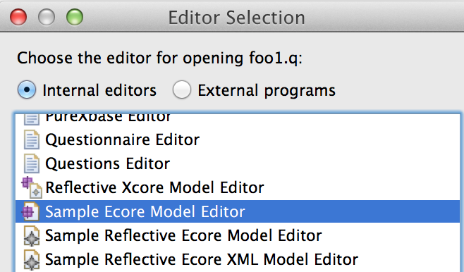
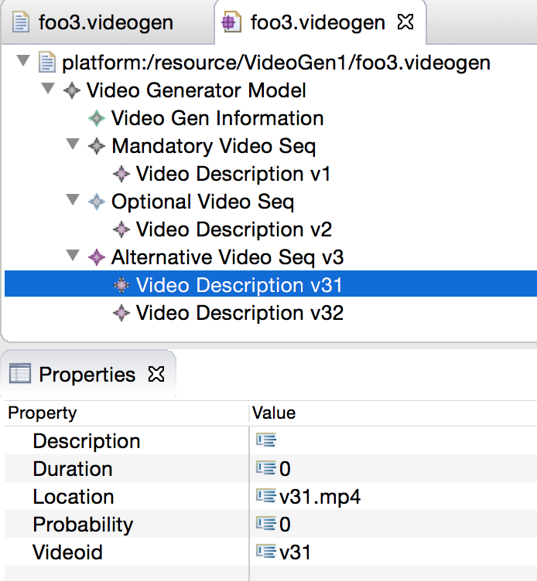
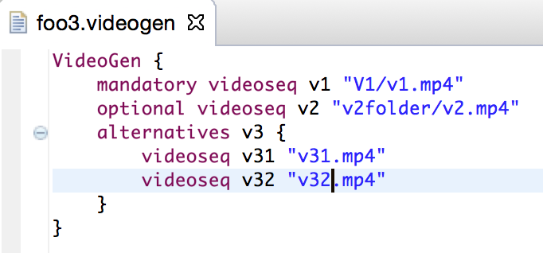
Loading Models (1)

Slide 51
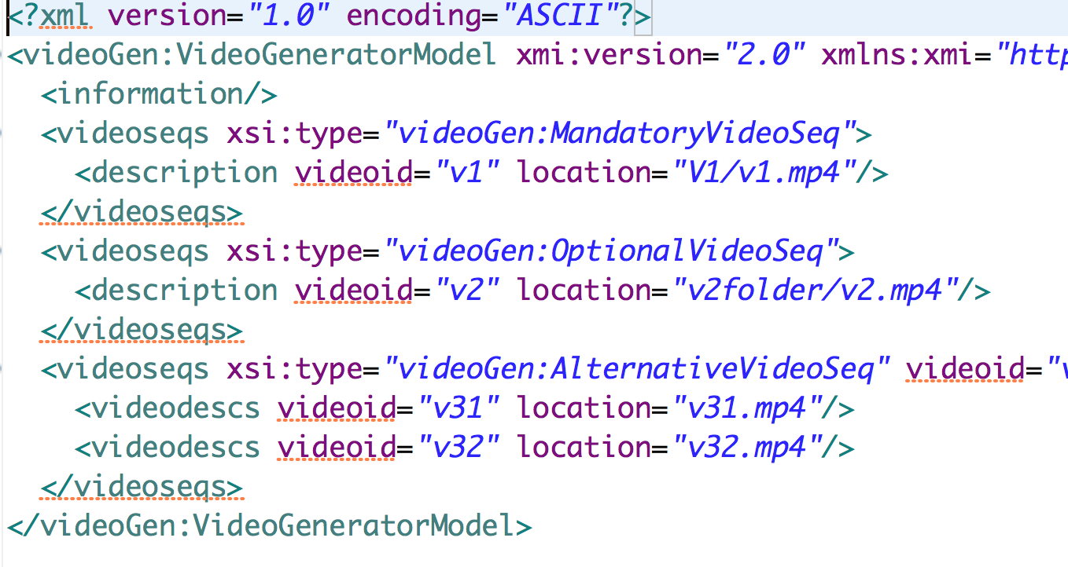
Loading Models (2)
Persistence of Models in
XMI (XML Metadata Interchange)

Slide 52


Slide 53

Loading Models (1)

Slide 54

Loading Models (2)
XMI

Slide 55
Loading Models (3)
Persistence of Models in
XMI (XML Metadata Interchange)

Slide 56



Meta(models) and Java

Slide 57

Meta(models) and Java
« Eclipse Modeling Framework (EMF) runtime support to produce a set of Java classes for the model »

Slide 58

http://eclipsesource.com/blogs/tutorials/emf-tutorial/

Slide 60


Questionnaire
MM (ecore)
Questionnaire
MM (ecore)
Questionnaire
Model 1 (xmi)
Questionnaire
Model 2 (xmi)

Slide 62


Slide 63
Contract
Practical foundations of model management
Learning and understanding Java 10 (aka Xtend)
advanced features of a general GPL, implementation of a sophisticated language using MDE
Model transformations
Model-to-Text
Model-to-Model
Metaprogramming
Revisit annotations (e.g., as in JPA or many frameworks)
DSLs and model management: all together (Xtext + Xtend)

Slide 64

What are the problems with this Xtext grammar?

Slide 65



Slide 66



Slide 67

The method description is undefined….

Slide 68
The method description is undefined….

Slide 69


Slide 71

Fixing the grammar

Slide 72




Slide 73
Grammar and Metamodel
Model transformations are defined on top of metamodel constructs
Co-design of grammar and metamodel
Grammar defines the syntax
Metamodel defines the structure
Xtext facilitates the metamodel design with
Default rules for inferring the metamodel from the grammar
Facilities to parameterize the inference
Some transformations may be difficult to express. In this case two possible attitudes:
Revise the Xtext grammar and the underlying metamodel
Design another metamodel (from scrath) and write a model-to-model transformation

Slide 74
Plan
Model Management in a nutshell
Loading, serializing, transforming models: scenarios
Taxonomy
Model transformation in Xtend
Xtend: a case study for GPL/DSL, MDE, and model transformation
Advanced features: extension methods, active annotations, template expressions
Xtend: behing the magic (Xtext+MDE)
Xtend + Xtext (breathing life into DSLs)
@Aspect annotation

Slide 75
Contract
Practical foundations of model management
Model transformations
Model-to-Text
Model-to-Model
Metaprogramming
DSLs and model management: all together (Xtext + Xtend)

Slide 76
Xtend
The Basics
(~ Java cheatsheet)

Slide 77

Hello World

Slide 78

Semi-colon is optional (within class, methods, etc.)

Slide 79

Package Declaration
Semi-colon ‘;’ is optional
‘^’ for avoiding keyword conflicts

Slide 80

Methods
By default: visibility conditions set to public

Slide 81

Methods
Type inference
(return type)

Slide 82


Method Calling
You can ommit parentheses

Slide 83

Fields
By default: visibility conditions set to private

Slide 84

Fields
primitive types of Java (int, boolean, etc) with autoboxing
var: type inference
val: constant, « final » in Java

Slide 85


Static Methods (::)

Slide 86


Pairs

Slide 87



Pairs

Slide 88


Immutable data structure

Slide 89


Constructor
Default visibility: public
override keyword: mandatory

Slide 90

Cast and Type

Slide 91

Extension Methods…
« … allow to add new methods to existing types without modifying them. »
The first parameter of a method can either be passed in after opening the parentheses or before the method call

Slide 92


Extension Method (local)

Slide 93



Extension Method (library)

Slide 94

Extension Method (library)

Slide 95

Lambda Expression (Java 8 will support it)
Anonymous classes can be found everywhere in Java code…
… And have always been the poor-man's replacement for lambda expressions in Java.

Slide 96


Lambda Expression (Xtend answer)
Anonymous classes can be found everywhere in Java code…
No need to specify the type for e
You can even ommit e

Slide 97



Lambda Expression (Xtend answer, more impressive examples)

Slide 98


Lambda Expression (Xtend answer, more impressive examples)

Slide 99

Templates

Slide 100
Templates (2)

Slide 101


Templates (3)
You already experiment with web templating engines (JSP, Scala templates in Play!, Symfony templates, etc.)
Alternatives exist in the modeling world
Multiple pre-defined and customizables generators
Xtend: seamless integration into a general purpose language

Slide 102

Xtend to Java

Slide 103

Xtend to Java (2) more after

Slide 104
Xtend/Xtext
Back to our scenarios

Slide 105
18, 167, 899

Slide 106


Refactoring

Slide 107
VideoGen
MM (ecore)
VideoGen
MM (ecore)
VideoGen
Model 1 (xmi)
VideoGen
Model 2 (xmi)

Slide 108
Endogeneous Transformation
VideoGen
MM

Slide 110
Templates

Slide 112

Facilities to create objects in a programmatic way

Slide 113
Lab Sessions
Overview

Slide 114
model-to-model
playlist
metamodel
playlist model
model-to-text

Slide 115
model-to-*
Thumbnails (vignettes) of each video sequence (e.g., PGN format)

Slide 116
Website/online
Random generation
Configurator
Game
…

Slide 117
Xtend
Advanced features (active annotation)
Model transformation in depth
MDE enables Xtend

Slide 118
http://www.eclipse.org/xtend/documentation.html
http://jnario.org/org/jnario/jnario/documentation/20FactsAboutXtendSpec.html
http://blog.efftinge.de/2012/12/java-8-vs-xtend.html
http://eclipsesource.com/blogs/tutorials/emf-tutorial/

Slide 119
Xtext.xtext?

